Slide 1








Modest-Pharo: Unit Test Generation Based on Traces and Metamodels
IWST 2024
Gabriel Darbord¹
Fabio Vandewaeter¹
Anne Etien¹
Nicolas Anquetil¹
Benoit Verhaeghe²
¹Univ. Lille, CNRS, Inria, Centrale Lille, UMR 9189 CRIStAL, F-59000 Lille, France
²Berger-Levrault, France
Notes:
Tool almost 2 years in development
Talk about BL
Fabio adapted it to Pharo during 1 month and a half of internship
Modest portmanteau (model + test)

Slide 2
The Importance of Testing
Nowadays, when developping new software systems:
20-50% time spent on testing
We test because we want:
Bug detection and prevention
Quality assurance
User satisfaction
Non-regression
Confidence
Etc.
Notes:
Nowadays, the importance of testing is an established fact
Time spent testing depends on software, up to 50%
Reasons:
QA: meet requirements, work as intended
Confidence: give developers and stakeholders confidence in shipping a good product

Slide 3
Our Test Generation Approach
Using software models and execution traces
static and dynamic analysis
Our objective is to generate tests that are:
Relevant
Readable
Maintainable
Not requiring existing tests
Not contaminating
Notes:
Relevant: verify correctness, increase confidence
Readable: easily understandable by humans
Maintainable: adaptable and resilient to changes
Not requiring existing tests
Contaminating: no need to change codebase

Slide 4
Test Oracles
How can we verify that a program returns the correct answer?
Mechanism that determines whether a test has passed or failed
Oracles hold the “truth”
In our case:
Consider legacy to be correct
Capture behavior using traces
Verify updated behavior matches traces
Non-Regression Testing
Notes:
In our industrial context, trusting legacy makes sense because it's been proven by time

Slide 5
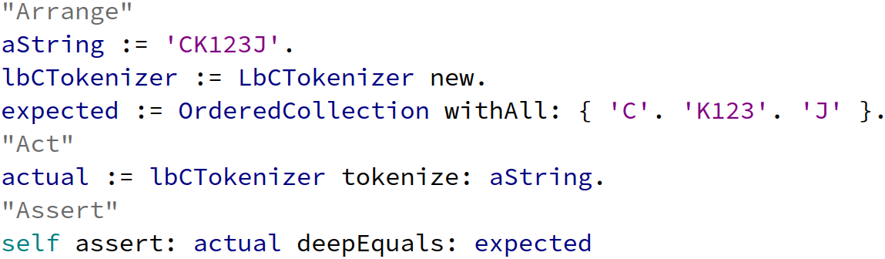
Example of a Generated Test
Notes:
Quick glance

Slide 6
Approach Steps
Notes:
Explain colors

Slide 7

Modeling with the Moose Platform
Modeling
Tracing
Parsing
Building
Exporting
Moose is a platform for software analysis
It allows to:
Represent a software system in a model
Query, manipulate, transform, and visualize models

Slide 8

Tracing by Instrumentation
Modeling
Tracing
Parsing
Building
Exporting
MetaLink, MethodProxies...
Before and after method
Requisite payload:
Identity of target method
Serialized arguments
Serialized return value
Serialized receiver
Notes:
Not contaminating!

Slide 9
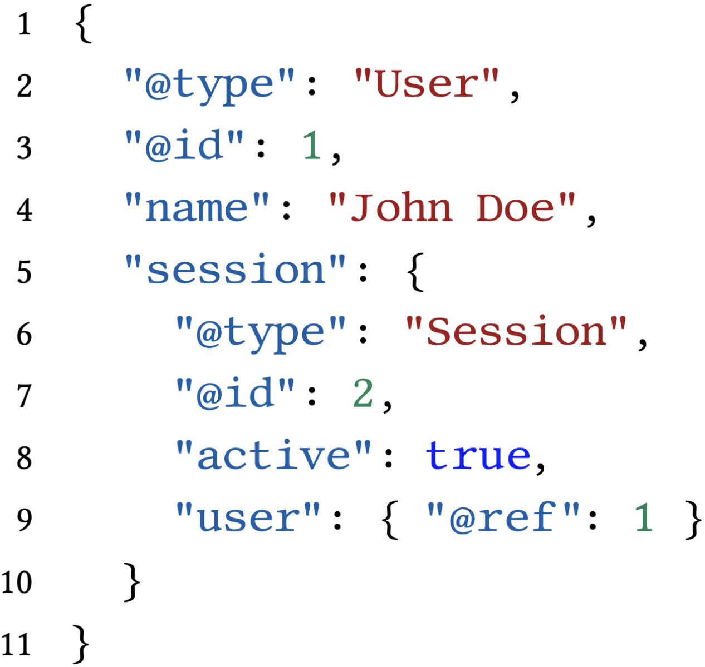
Parsing Trace Data
Modeling
Tracing
Parsing
Building
Exporting
JSON based on Jackson
Type metadata
Dynamic typing
Object identity metadata
Circular dependencies
Easy to
write
parse
github.com/Modest-Project/PharoJackson
Notes:
Type because dynamic typing
ID because circular dependencies
NOT easy to read by humans, we don't want it in tests

Slide 10
Building Test Model
Modeling
Tracing
Parsing
Building
Exporting
Notes:
Pause (water)

Slide 11
Exporting Test Model
Modeling
Tracing
Parsing
Building
Exporting
Use reflectivity to create packages, classes and methods
Write the code using Pharo’s AST

Slide 12

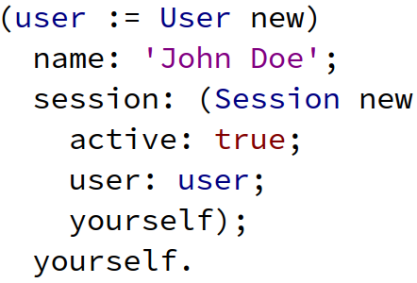
Reconstructing Values
Notes:
Type and ID metadata
Reflectivity when setter is not available
Handle all kinds of classes (instSpec), including closure

Slide 13
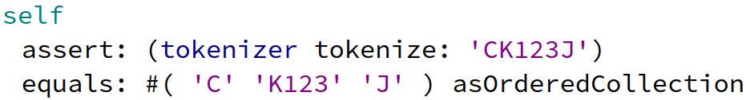
Example of a Generated Test (bis)
Existing test
Generated test
Notes:
Pause
Structural equality

Slide 14
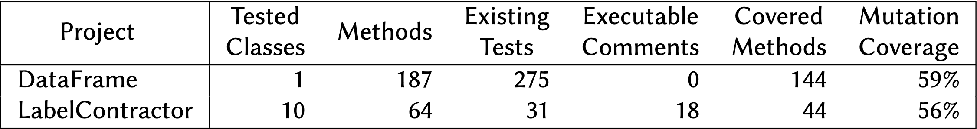
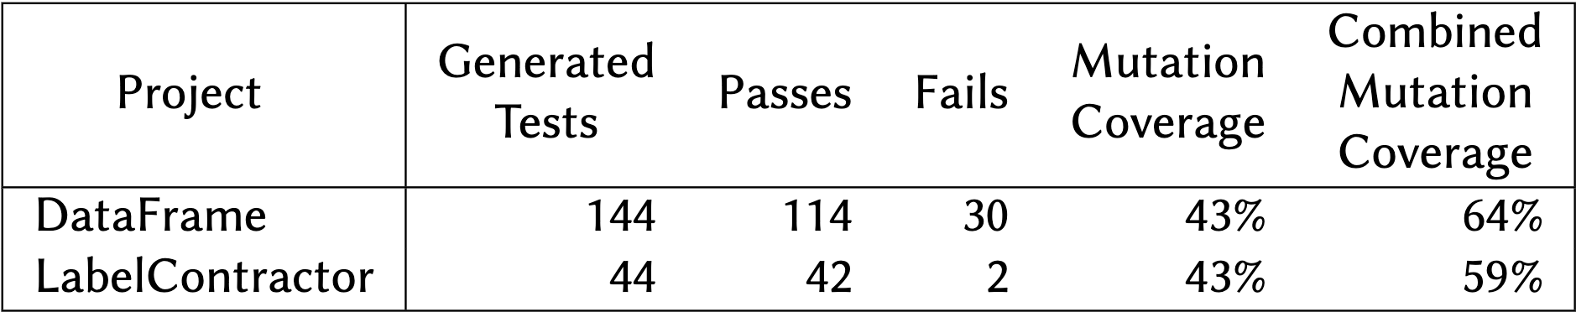
Results
About target projects
About generated tests
Notes:
DataFrame: Python’s pandas
Executable comments are interesting for scenarios
Generated one test per covered method
In parenthesis: total mutation coverage -> increases thanks to structural equality

Slide 15

Conclusion
Notes:
Observation-based testing tool applied to Pharo
Future work on Pharo with Cormas
Thanks BL, future work on Java on huge legacy systems

Slide 16

Future Work
Pursue test quality
Relevant, readable, maintainable…
Evaluate our approach in Pharo, thanks to our community
Compare existing tests to generated tests
Generate unit tests for our industrial partner Berger-Levrault
UT
Notes:
BL -> industrial context

